Slide 1

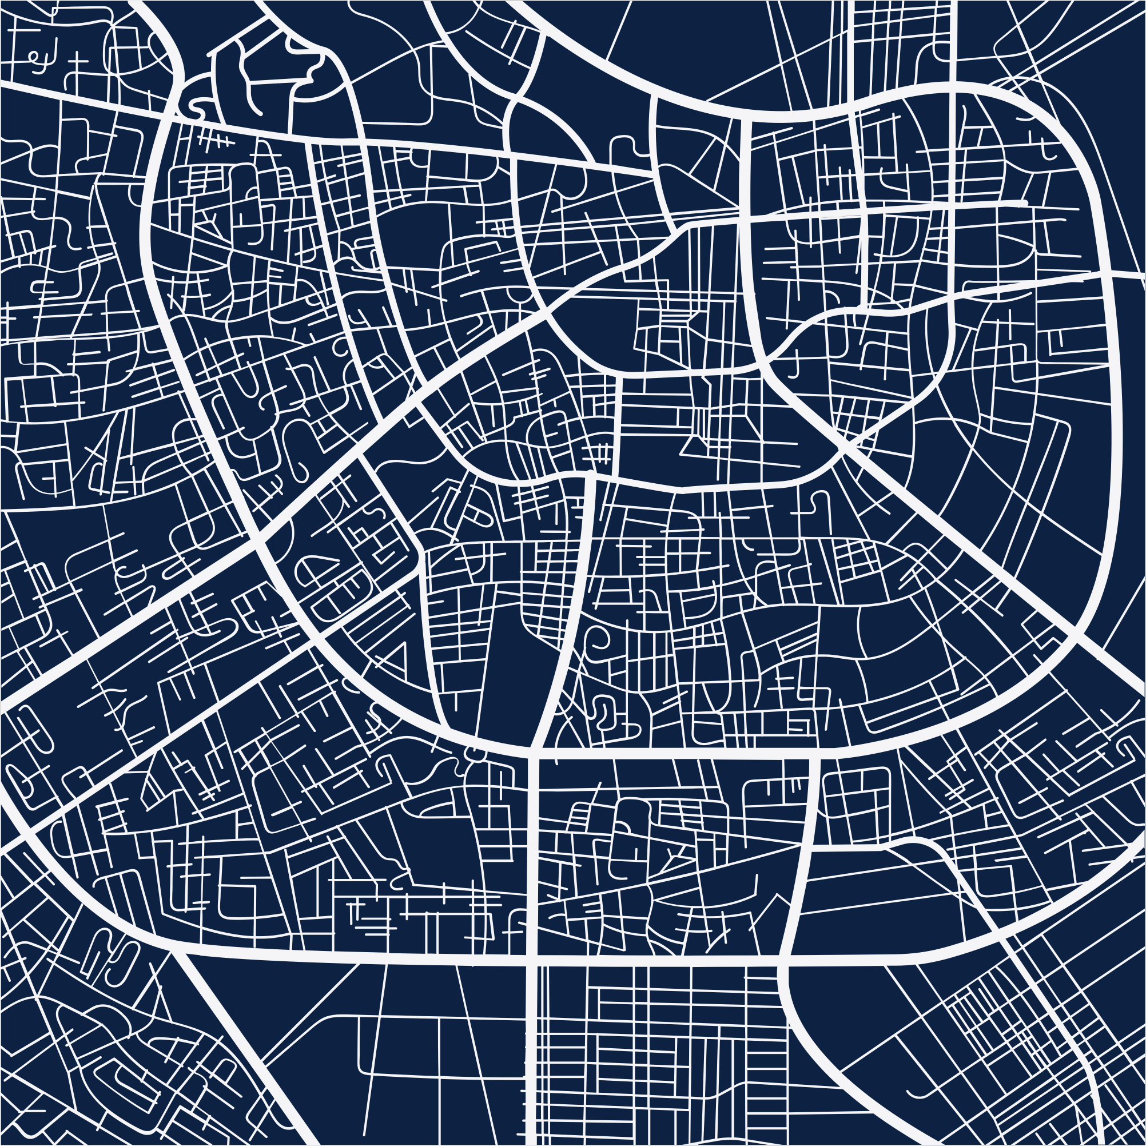
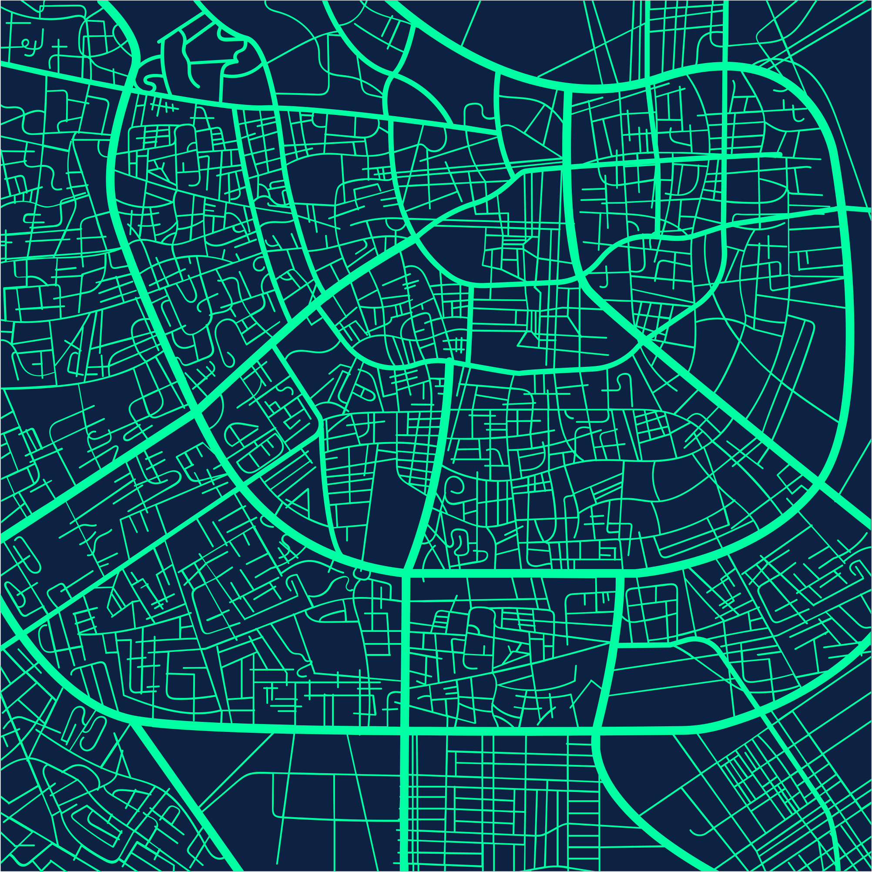

Highway security system
Team Members :
Hemashri S
Calvin Davis SR
Eugine Carmel P
Ben Stanes J
Team Name :
CAGE DECODERS

Slide 2
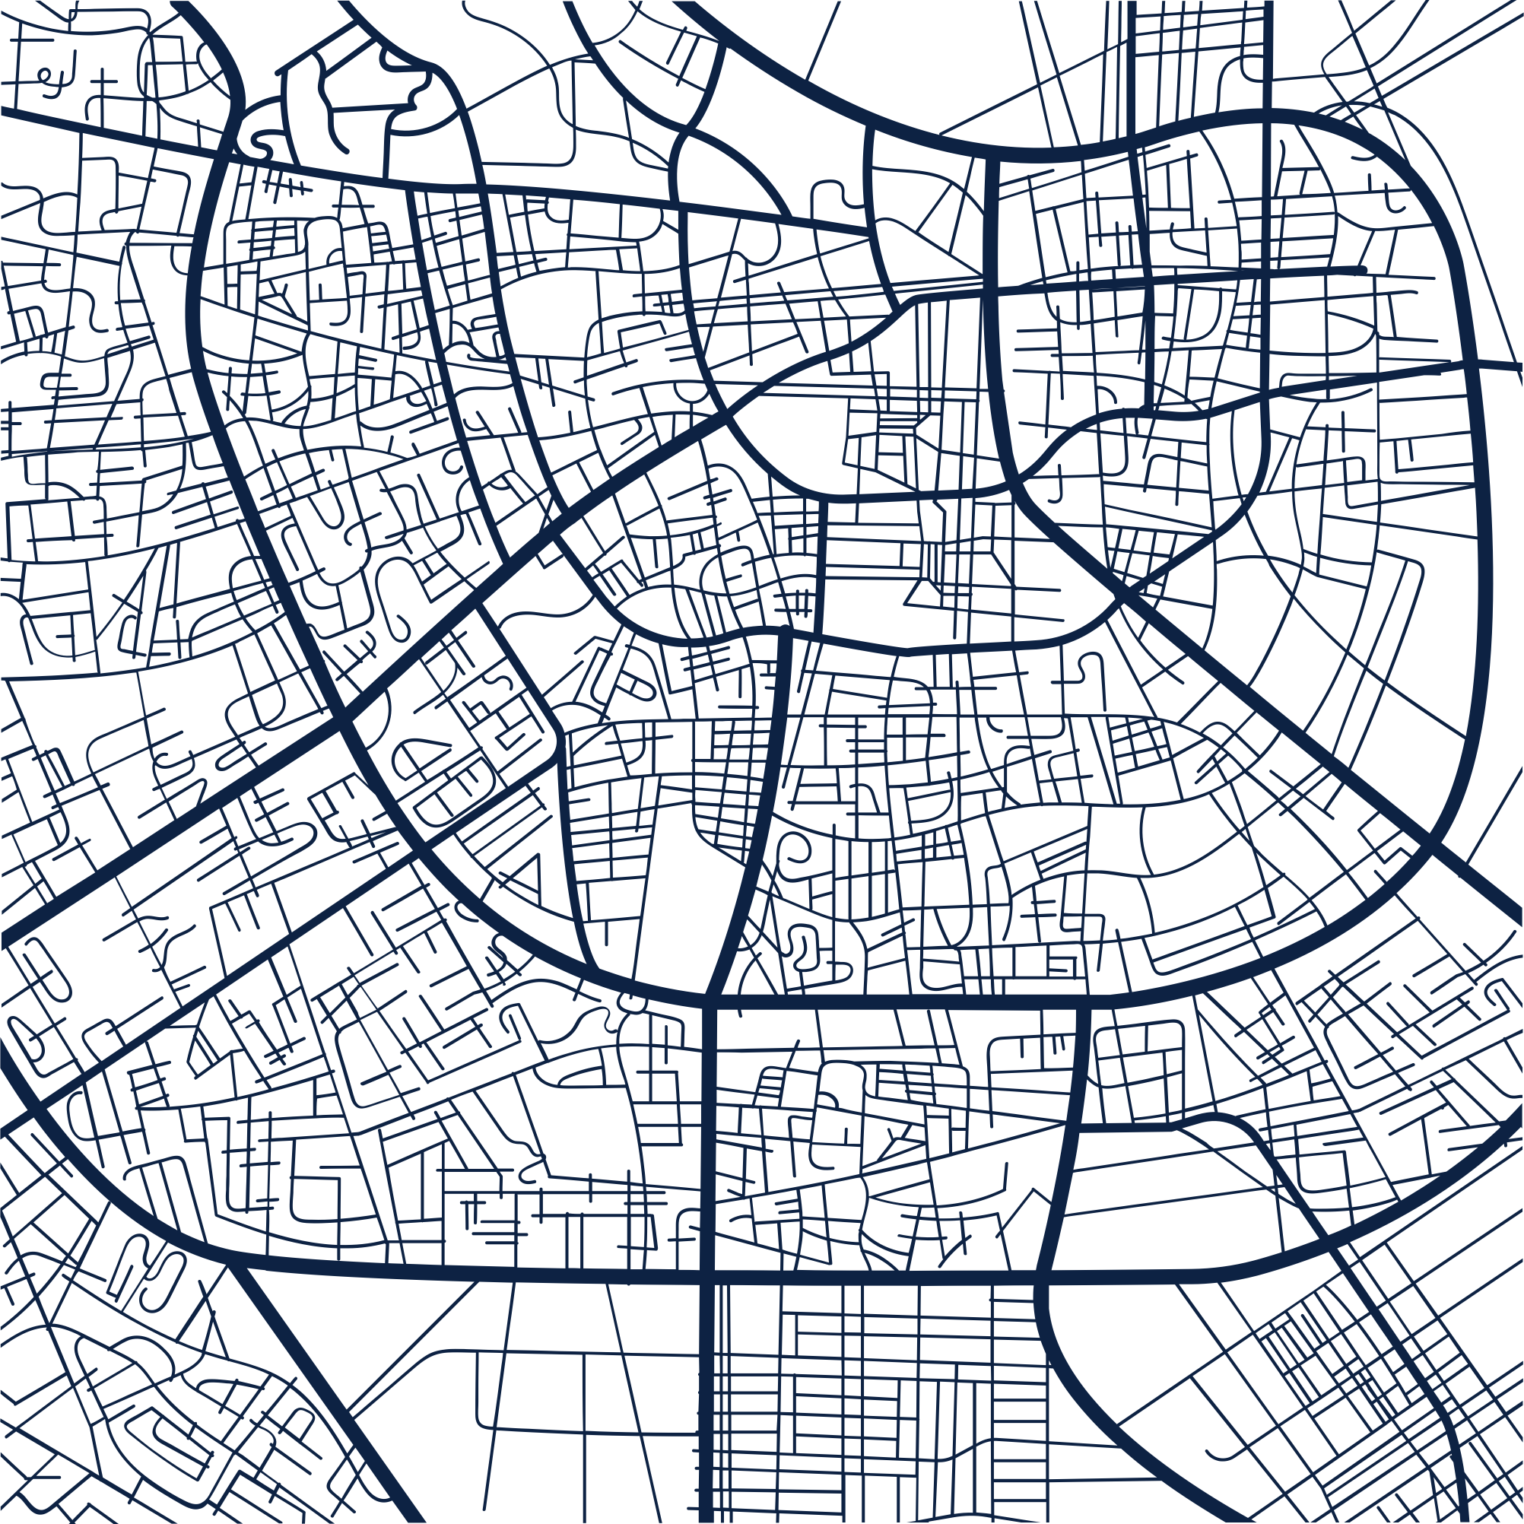
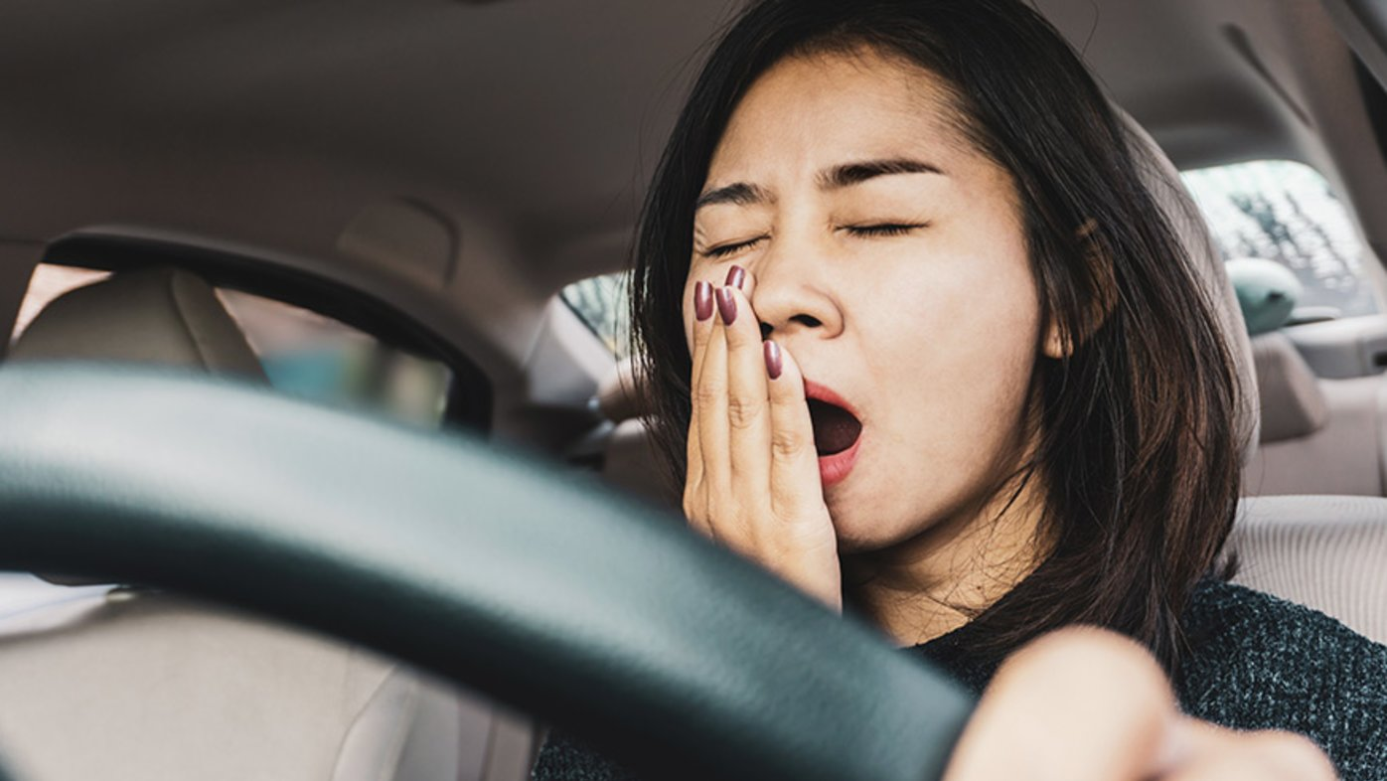
PROBLEM STATEMENT
These days, exhaustion had been a major cause of vehicle accidents that result in numerous fatalities on roads and in other unforeseen places.

Slide 3

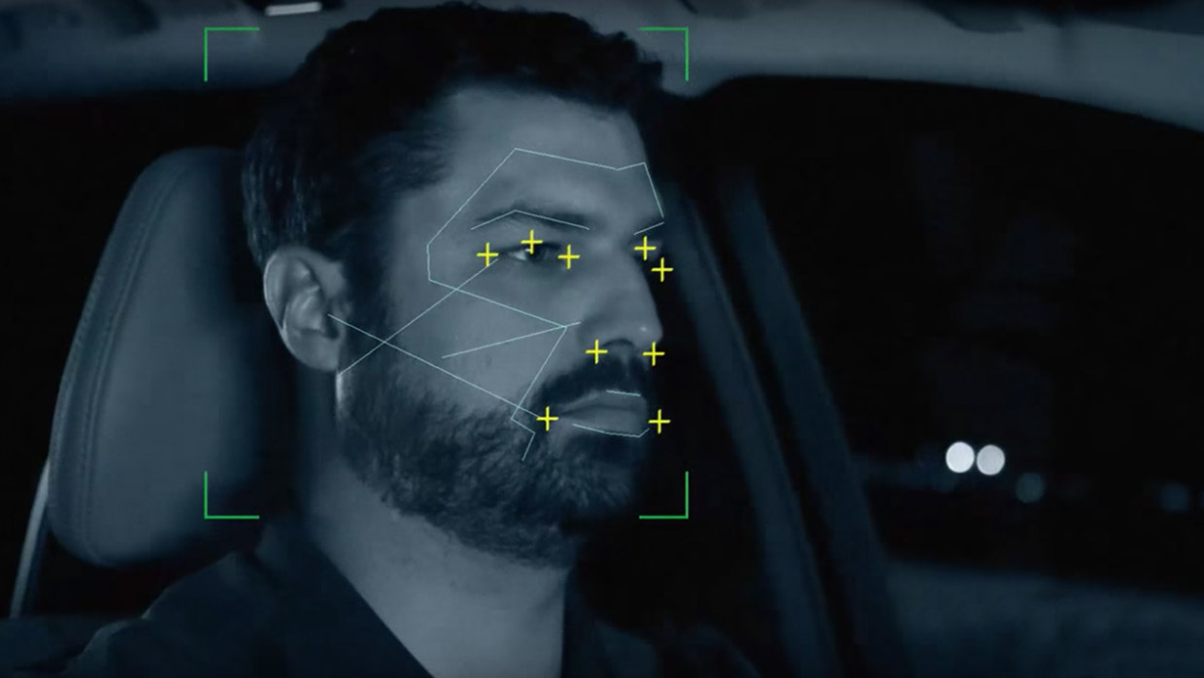
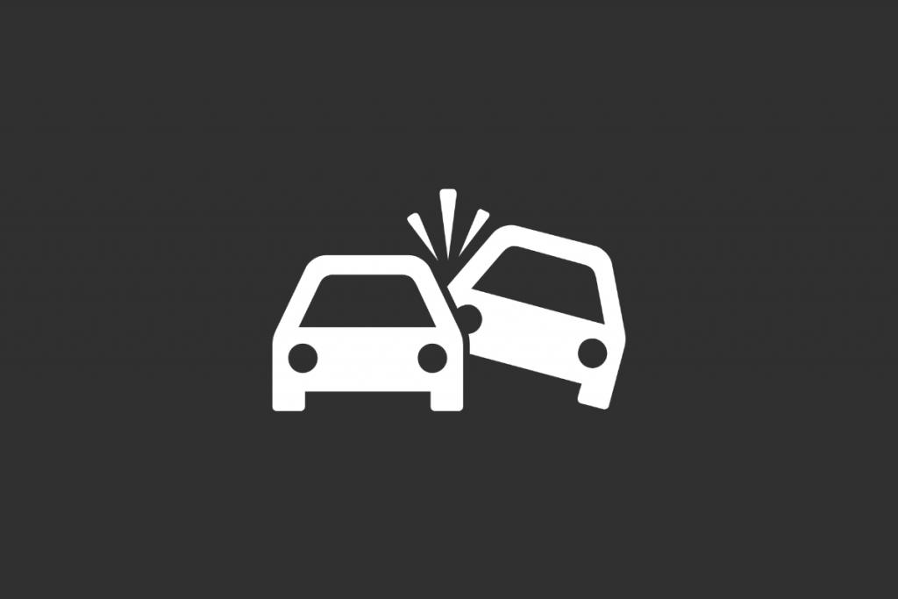
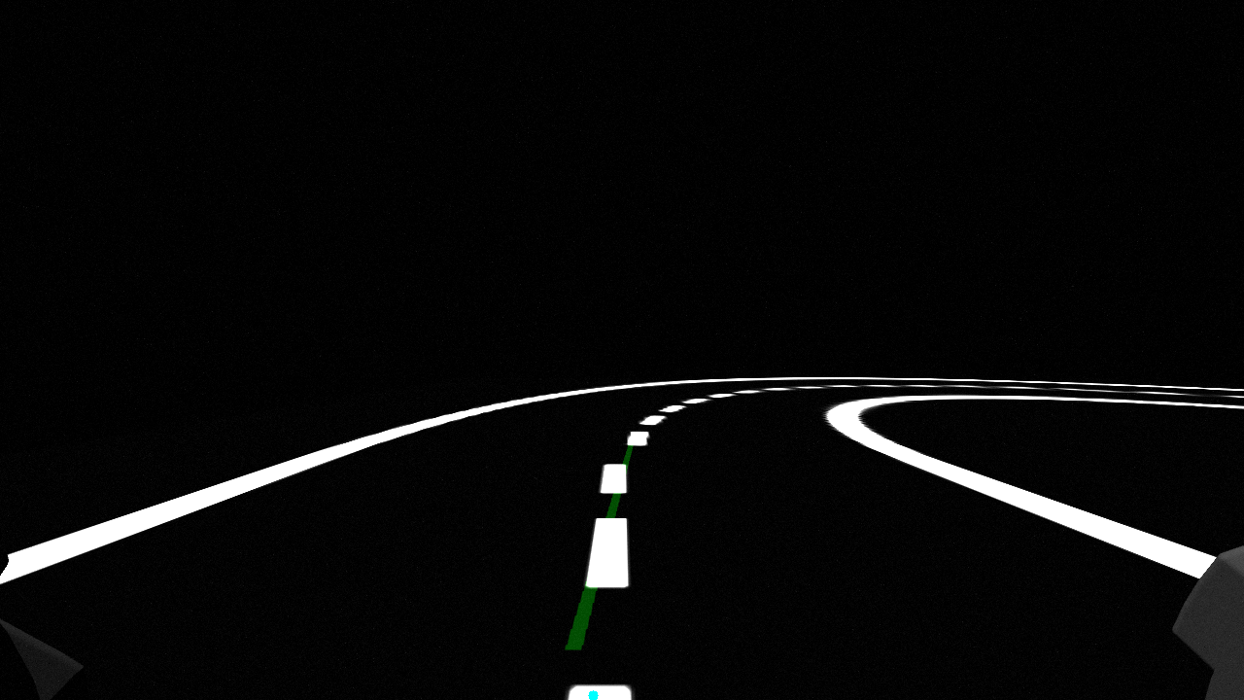
Objective
Detecting drowsiness activity from the driver
Detecting accidents and alerting the driver.
Detecting highway lanes to the driver

Slide 4

Proposed Solution
A 24/7 dashcam with two cameras, one facing the road, the other facing the driver.
The driver camera detects drowsiness, while the road facing camera detects accidents happening in front of the vehicle.
When detected the system send off an alarm that alerts the driver.

Slide 5
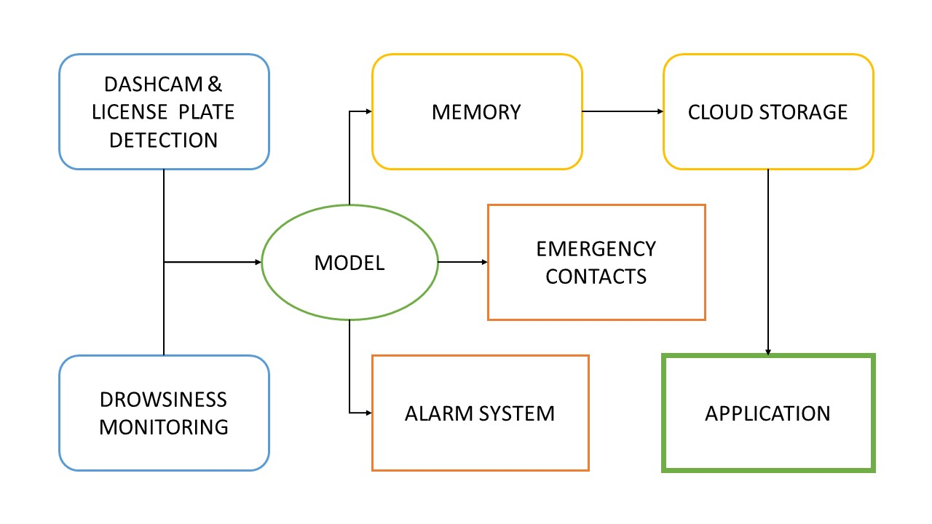
Workflow Approach
Lane Detection

Slide 6
KEY FEATURES AND FUNCTIONALITY
Drowsiness Detection
Accident Detection
Lane Detection
TECHNICAL APPROACH
NumPy
Python
TensorFlow
Matplotlib
cv2

Slide 7
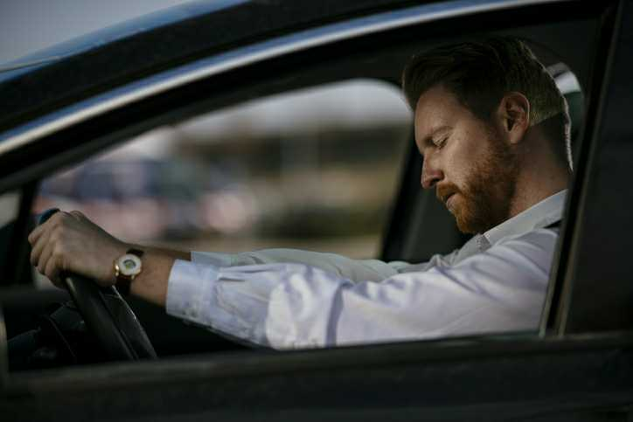
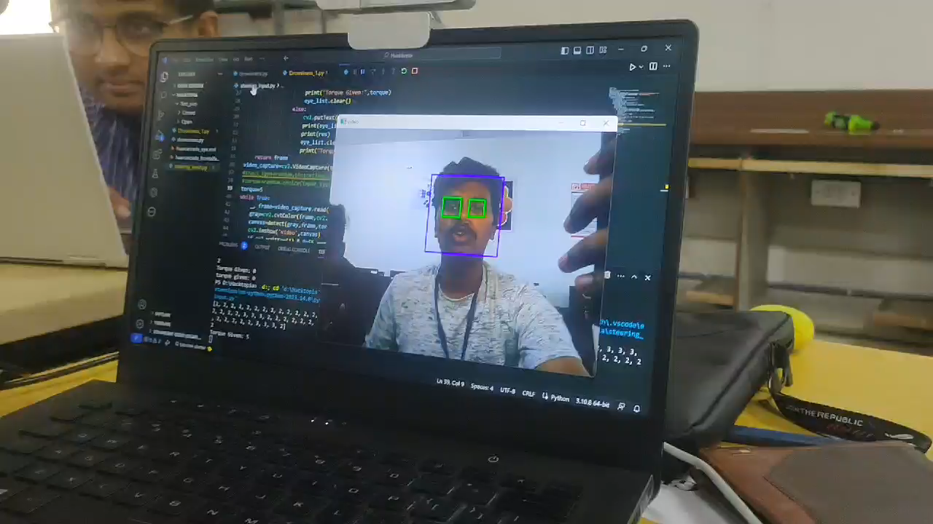
DROWSINESS DETECTION
A front cam is fixed facing the driver which detects whether the eyes of the driver is closed or not.
haarcascade.xml is used here to detect the eyes of the driver.
The driver’s face and eyes are detected separately by the drowsiness model.
This outputs 2 or more if the eyes are open and 0 or 1 if the eyes are closed.

Slide 8
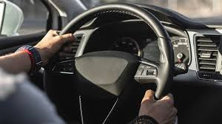
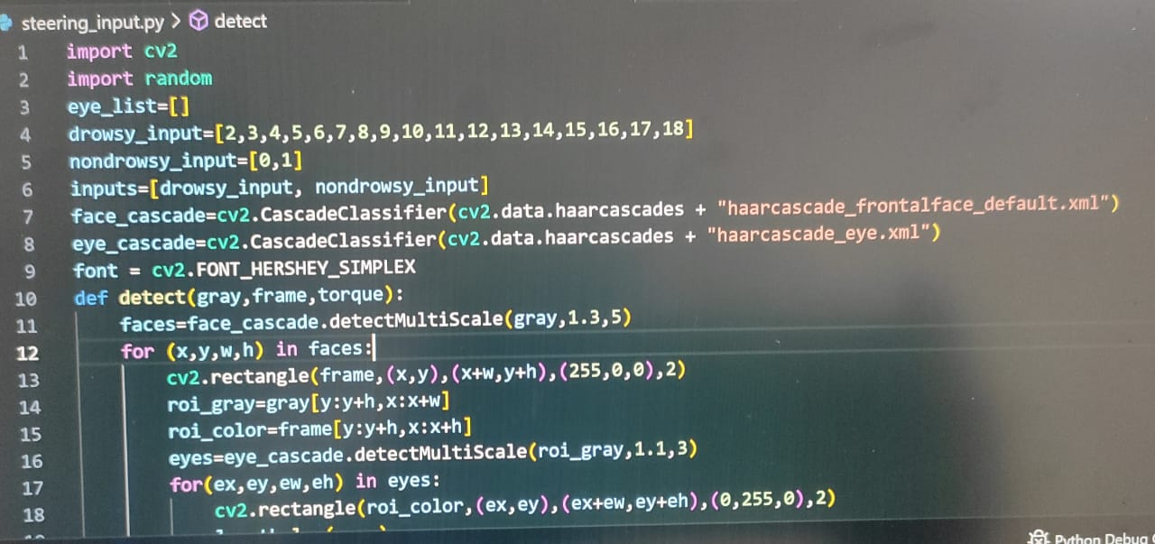
STEERING TORQUE INPUT
DETECTION
..
Input from the steering’s sensor is used to detect a driver’s consciousness while the eyes are wide open.
If the eyes are open but torque is not applied on steering wheel, it is considered drowsiness, also if torque is applied on the steering wheel but eyes are closed it is also detected drowsiness.

Slide 9
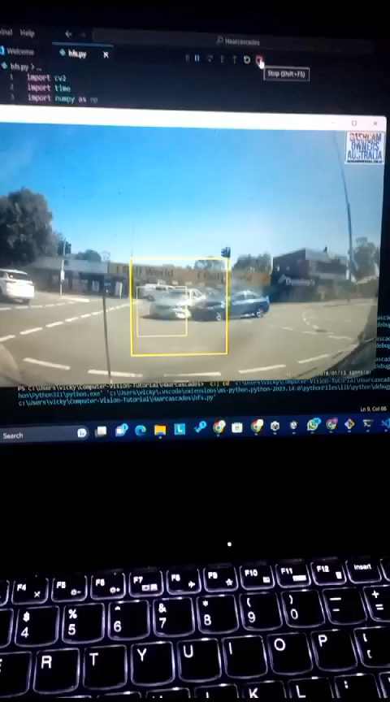
ACCIDENT DETECTION
The rear cam which detects lane also detect accidents occurred at the front.
After detection it alerts the driver about the accident to prevent further chaos.
This is implemented using Residual neural networks API, Tensorflow, Opencv and Keras .

Slide 10
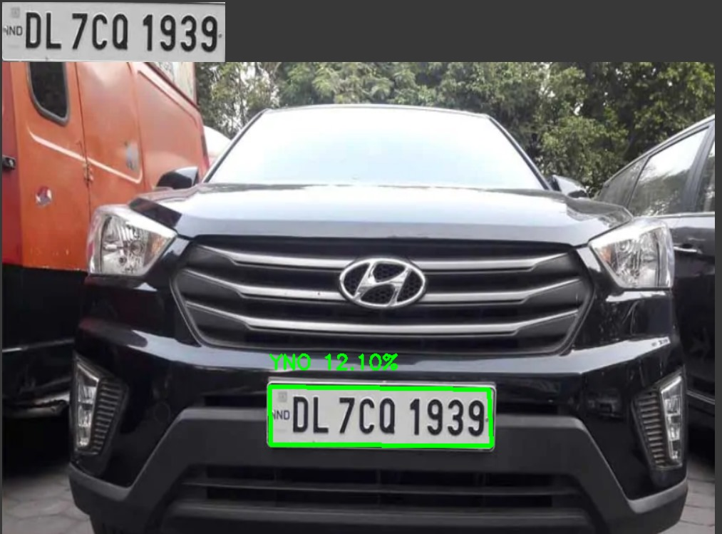
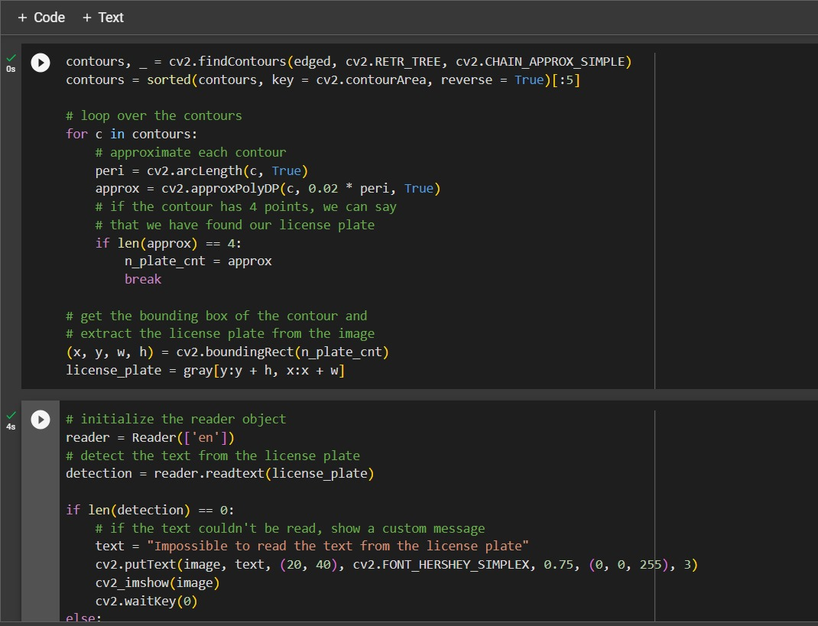
NUMBER PLATE DETECTION USING QUANTUM NEURAL NETWORK
The dash cam used to detect number plate of the vehicle within it’s visibility .
These are been stored in arrays by frames when an accident happens.
Grover's algorithm is based on quantum computing is used to analyse and extract the text from the Number plate.
This gives more accurate and optimized solution using qubit frames .

Slide 11
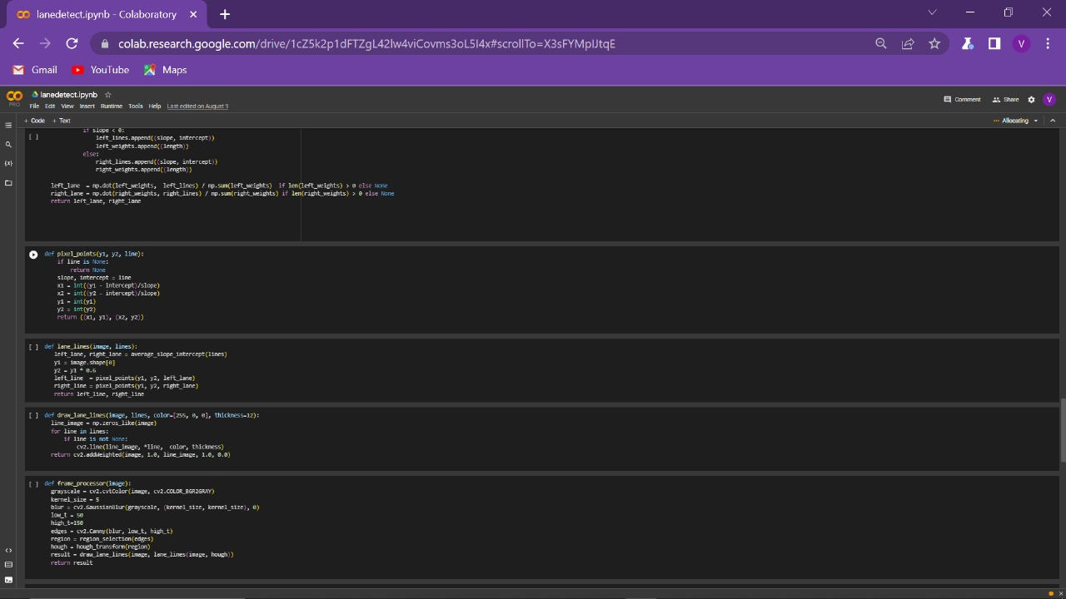
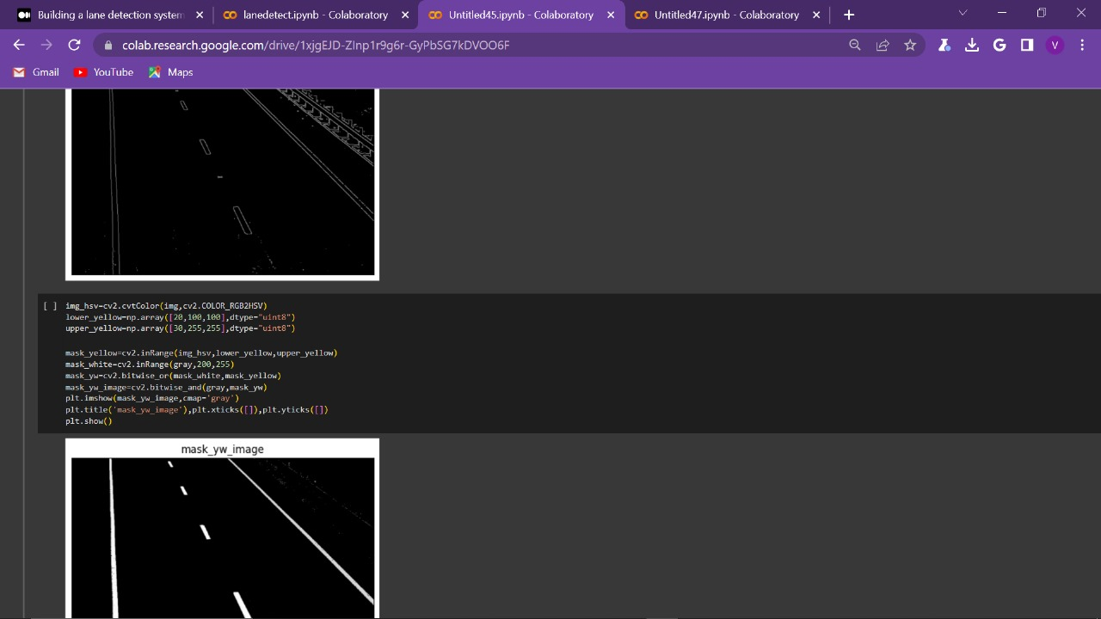
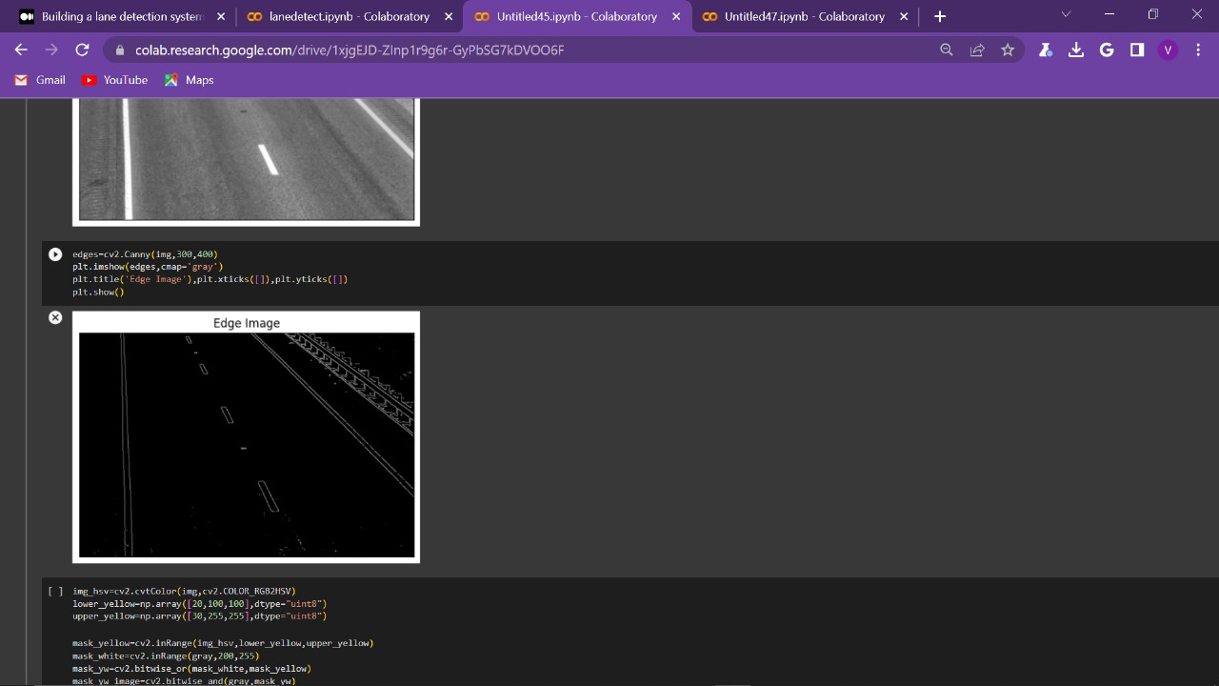
LANE DETECTION
Lane detection helps the driver to stay on track of the highway.
A rear cam is fixed facing the road at front to detect the lane of the highways.
This is implemented by importing cv2, NumPy, Pandas.
Region selection and Hough transform is applied for detecting the lanes of the highway.

Slide 12
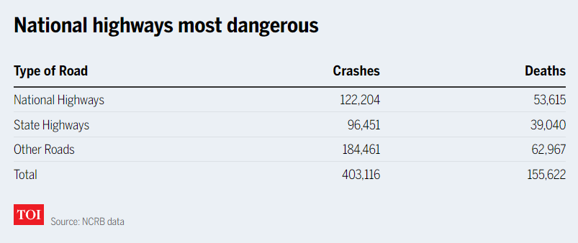
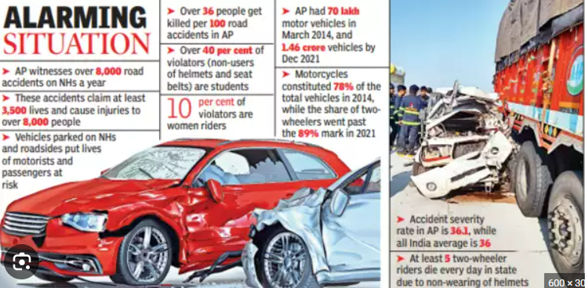
ARTICLES REGARDING ACCIDENTS IN HIGHWAYS DUE TO DROWSINESS
According to Times of India, The Highest numbers of deaths in road accidents were reported on the National Highways accounting for 34.5% (53,615 out of 1,55,622) followed by State Highways (25.1%) (39,040 deaths).
Another Article added that Secretary of Agra Development Foundation(ADF) KC Jain, who has been working on the subject of road safety for several years and had filed the RTI, said, Driver’s sleep deprivation is major contributor of deadly accidents.

Slide 13
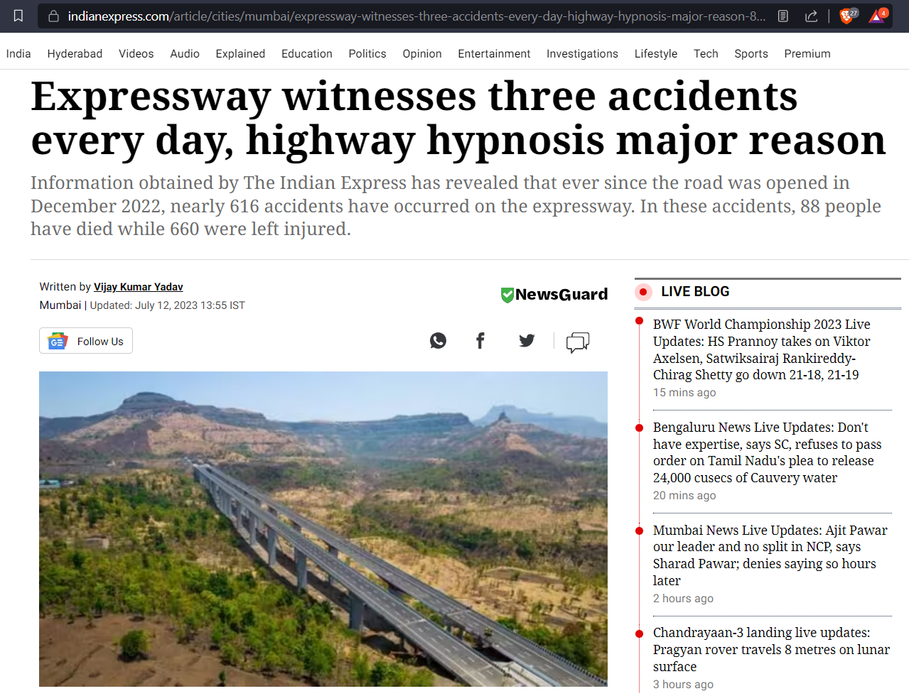
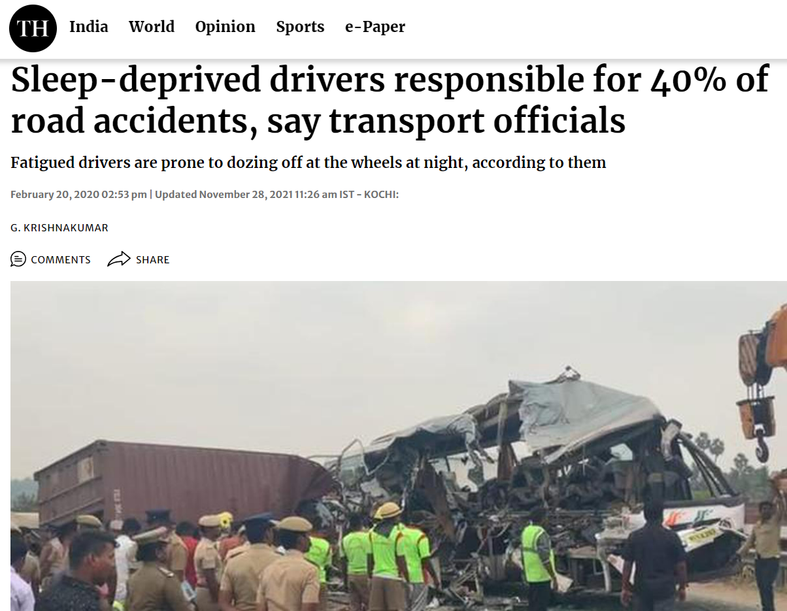

Slide 14

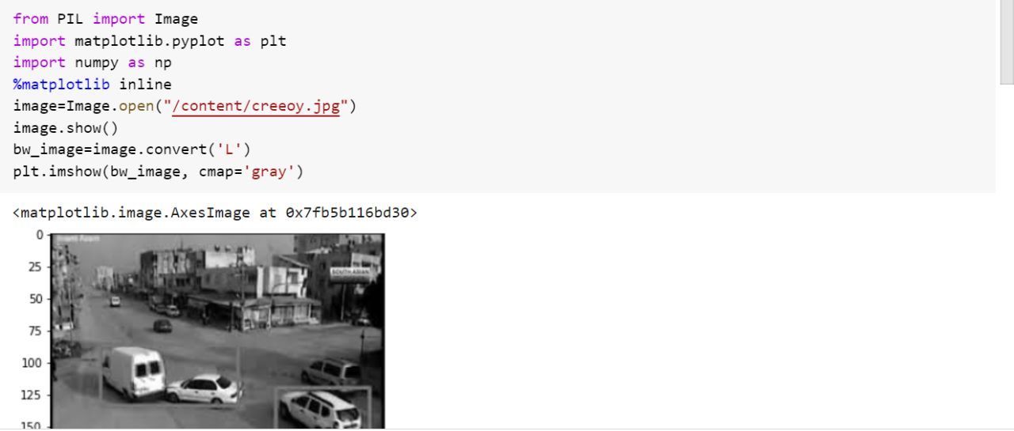
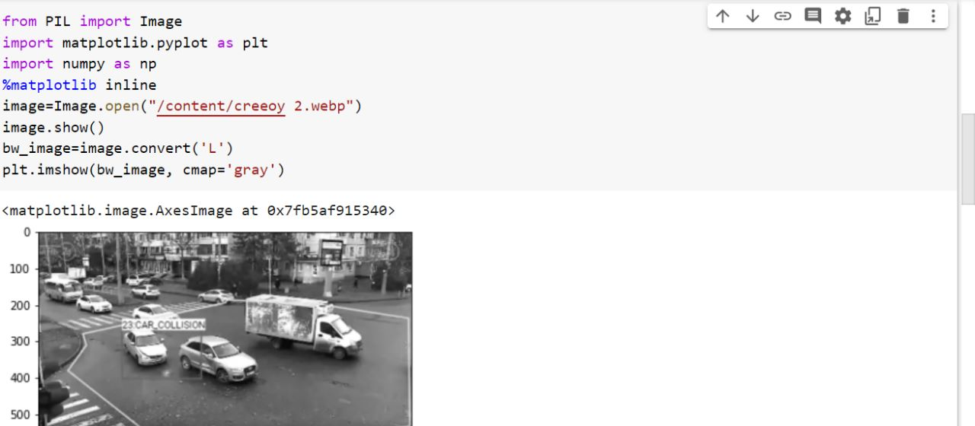
Technology Used
The packages and Modules that is used in this prototype are :
Modules:
Open cv, Tensor flow, Kivy
HTML, CSS
Algorithm:
Masked RCNN
Packages:
Pandas, Numpy, mathplotlib
Easy-OCR

Slide 15
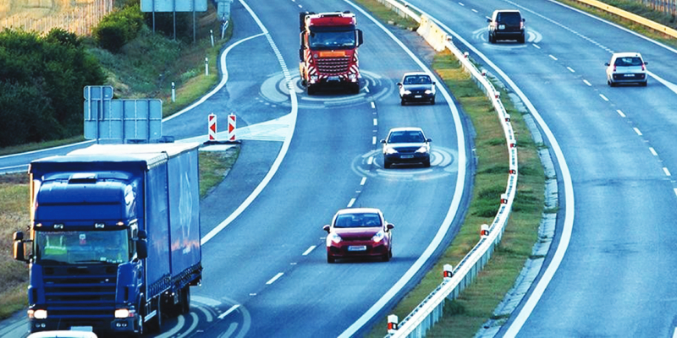
•
RESOURCES REQUIRED
AND TIMELINE
Various datasets in order to train the model in different environments for accurate results.
The datasets are based on image annotation.
This prototype is in it’s final stage of approach.

Slide 16
Description Of Our Applicability :
Long driving heavy vehicles where almost daily accidents occur due to driver fatigue.
Operators at nuclear power plants where continuous monitoring is necessary, could make use of our drowsiness detecting system.
In case of bike accidents , we can predict the type of vehicle which causes the accident role.
Above all the system can also act as an 24/7 dashcam, recording high quality footage.

Slide 17
Relative Feature
Types of vehicles are clearly identified which causes the particular
accident.
Adaptive non-sensor cruise control.
Lane change alarm system(only when indicators are not used).
Night vision, grayscale can be implemented to display objects in the infotainment during bad lit conditions.
Water sprinkler can be fixed that activates when drowsiness is detected.

Slide 18
THANK YOU

